Slide 1

Electrical and Electronic Properties
Dr. J. Venkatramani
219-B
venkatramani@iiitdm.ac.in

Slide 2
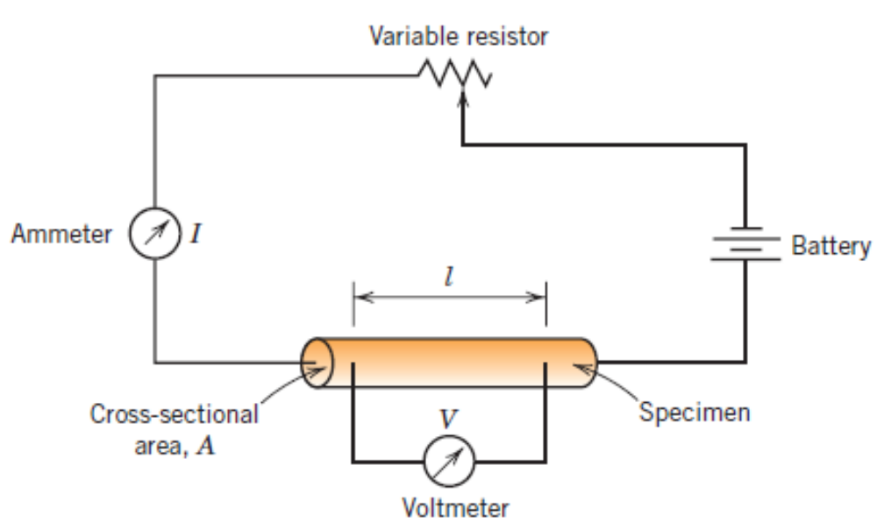
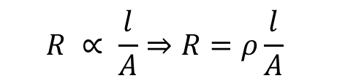
OHM’s Law
V = IR
$$R ∝ \frac{l}{A}⇒R=ρ\frac{l}{A}$$

Slide 3

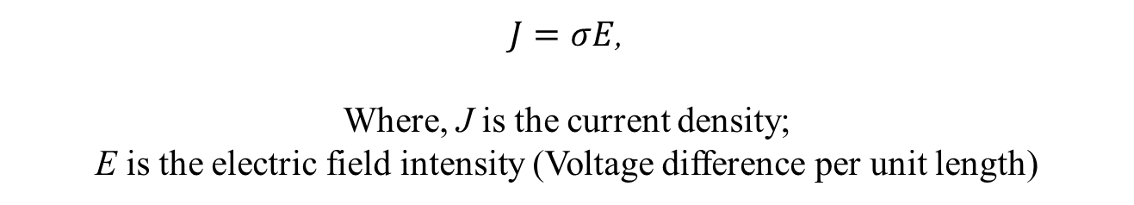
Electrical Conductivity
$$σ=\frac{1}{ρ}$$
An equivalent statement of Ohm’s law:
$J=σE$,
Where, J is the current density;
E is the electric field intensity (Voltage difference per unit length)
Classification of metals based on conductivities:
Conductors
Insulators
Semiconductors

Slide 4
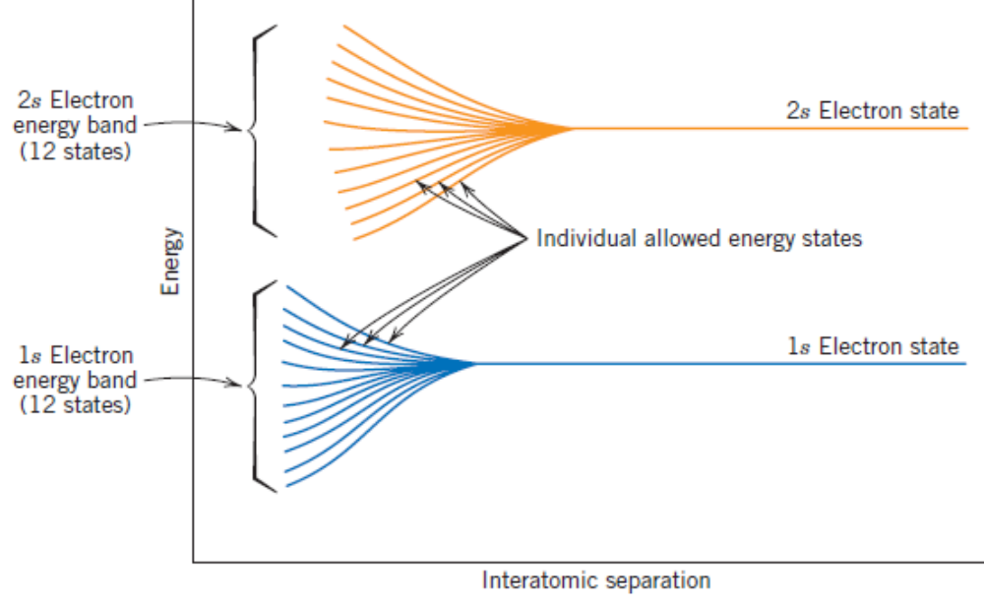
Electronic and Ionic Conduction
Energy levels for a group of 12 atoms.

Slide 5
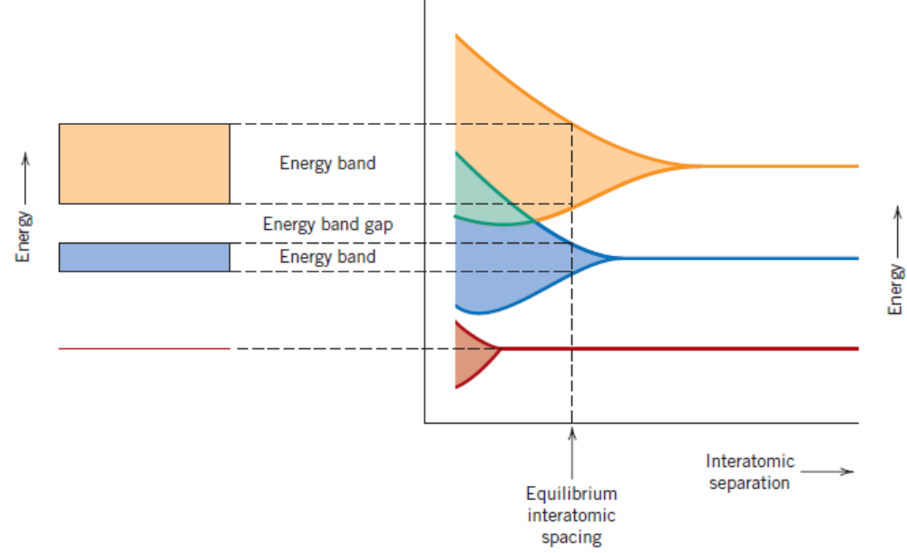
Electronic and Ionic Conduction
Energy levels for a group of atoms.

Slide 6
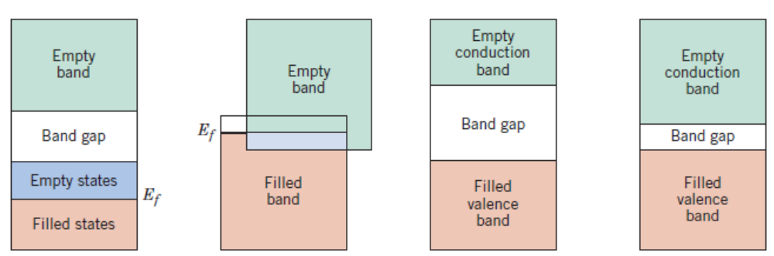
Electronic and Ionic Conduction
Example: Copper
Example: Magnesium
Example: Insulators
Example: Semiconductors

Slide 7
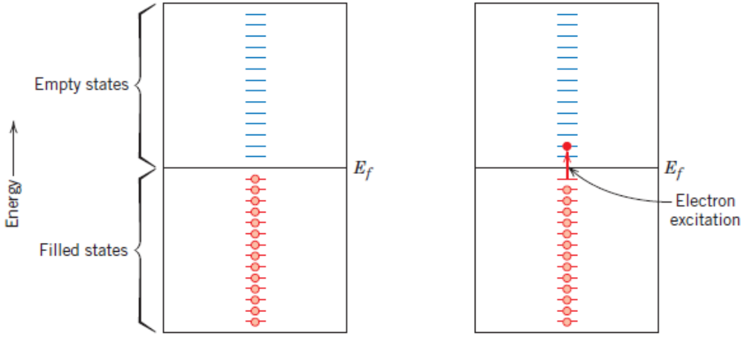
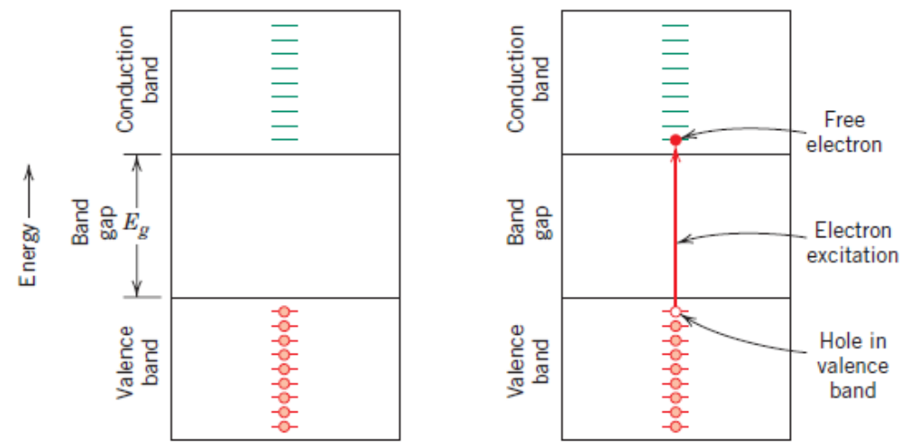
Electronic and Ionic Conduction
For metals
For insulator or semiconductor

Slide 8
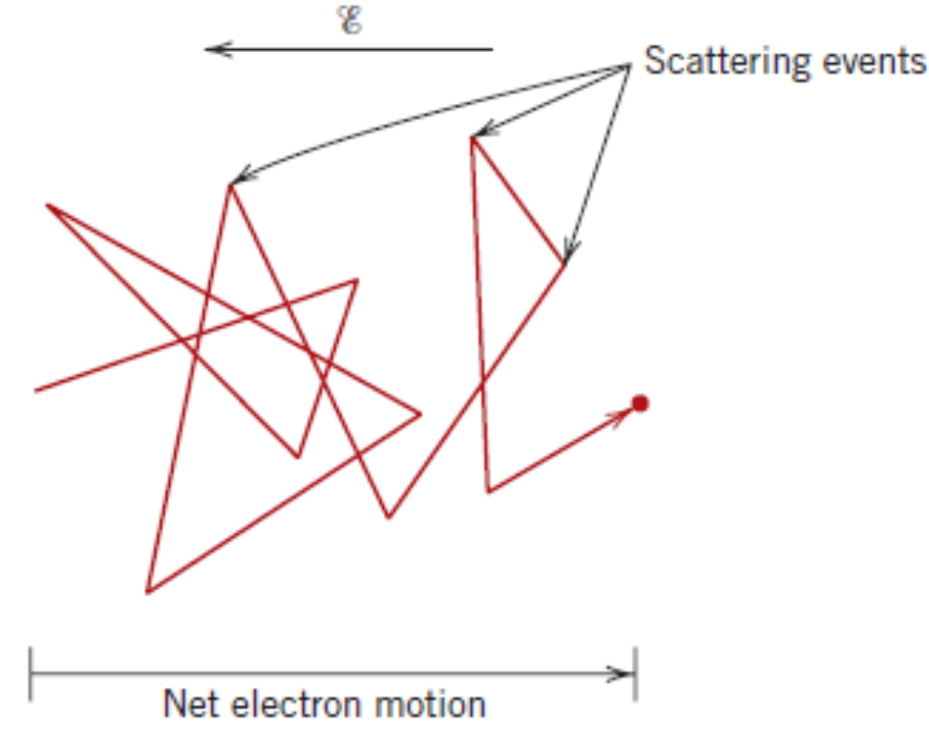
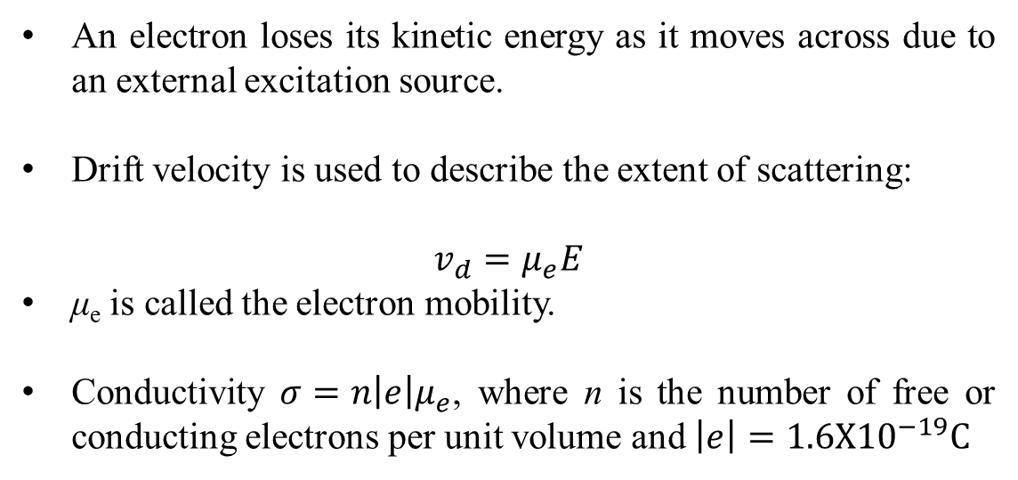
Electron mobility in a crystal
An electron loses its kinetic energy as it moves across due to an external excitation source.
Drift velocity is used to describe the extent of scattering:
$$v_{d}=μ_{e}E$$
μ_{e} is called the electron mobility.
Conductivity $σ=n{\left|e\right|μ}_{e}$, where n is the number of free or conducting electrons per unit volume and $\left|e\right|=1.6X{10}^{−19}C$

Slide 9
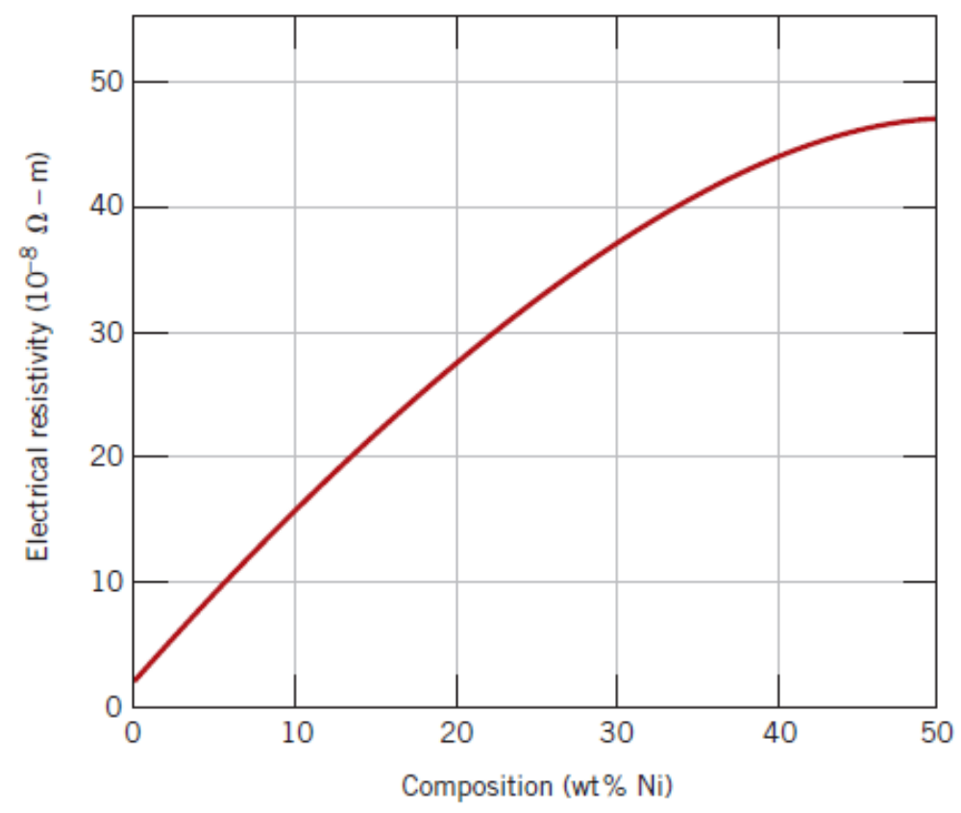
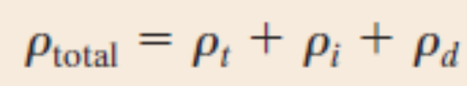
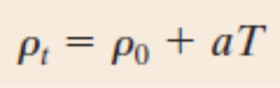
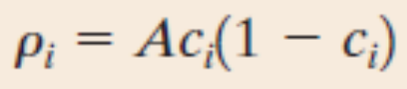
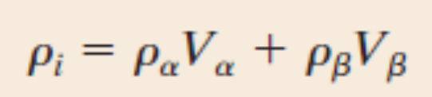
Electrical Resistivity of Metals
Matthiessen’s rule: overall resistivity of a metal is sum of the contributions from each of the factors – thermal, impurities and plastic deformation.

Slide 10
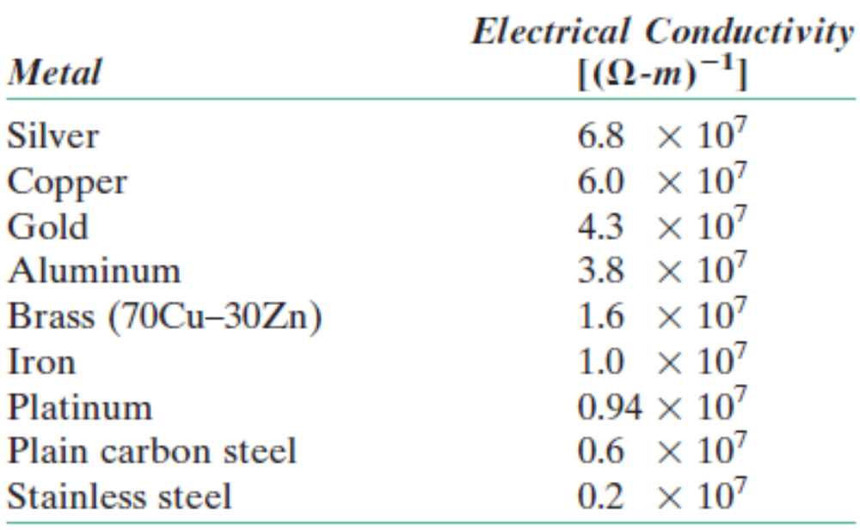
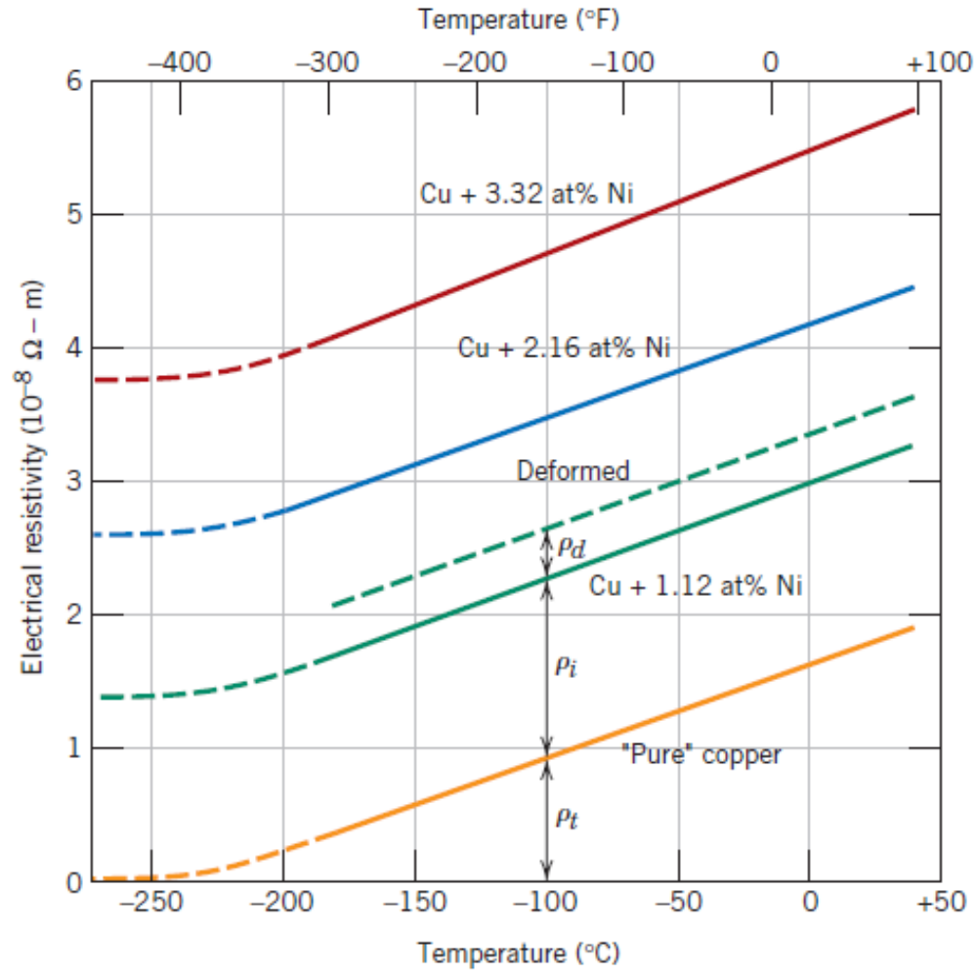
Electrical Resistivity of Metals

Slide 11
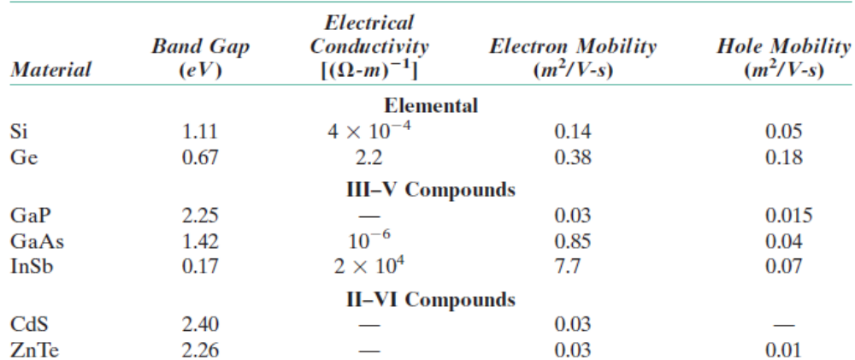
Semiconductivity
Intrinsic Semiconductors: Band gap < 2ev.
Examples: Si, Ge, GaAs, InSb

Slide 12
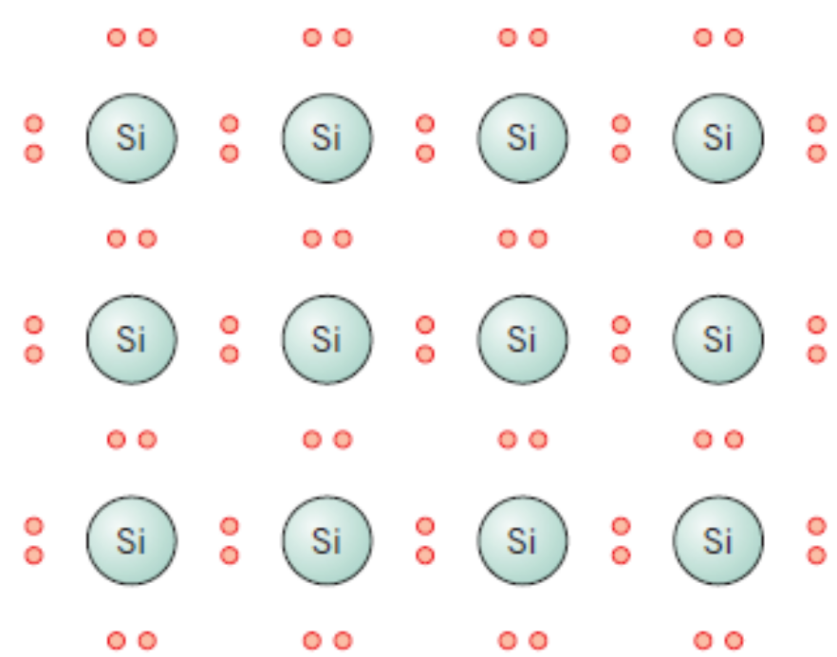
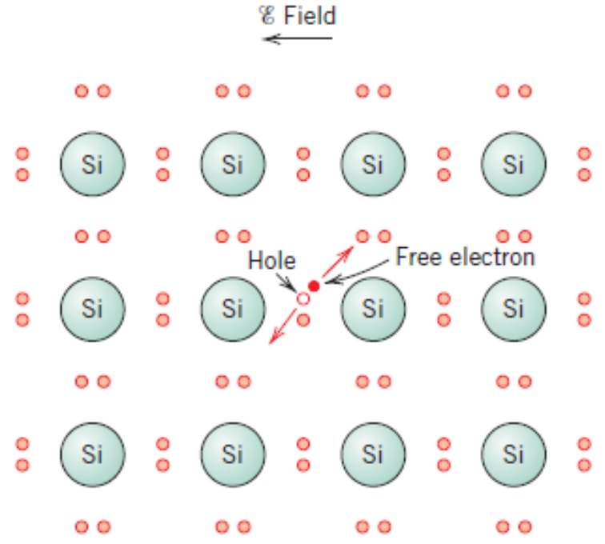
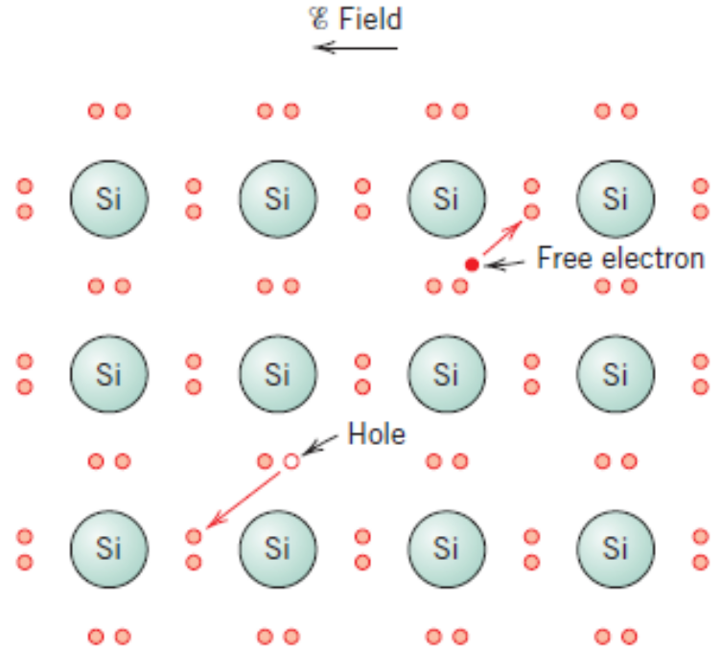
Intrinsic Conductivity

Slide 13
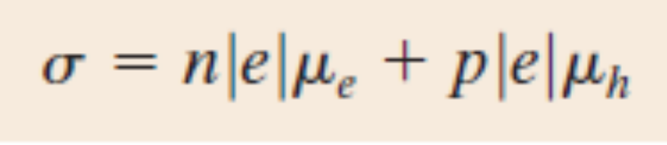
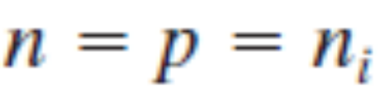
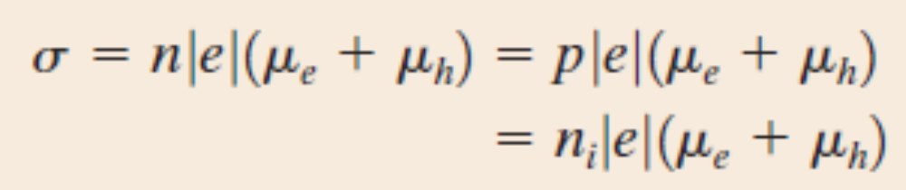
Intrinsic Conductivity
n_{i} is the charge carrier concentration

Slide 14
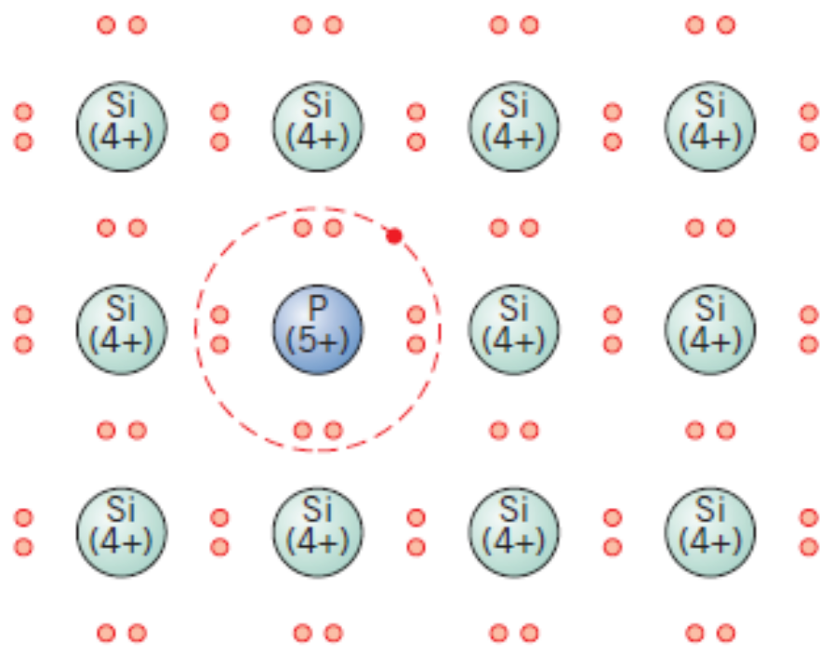
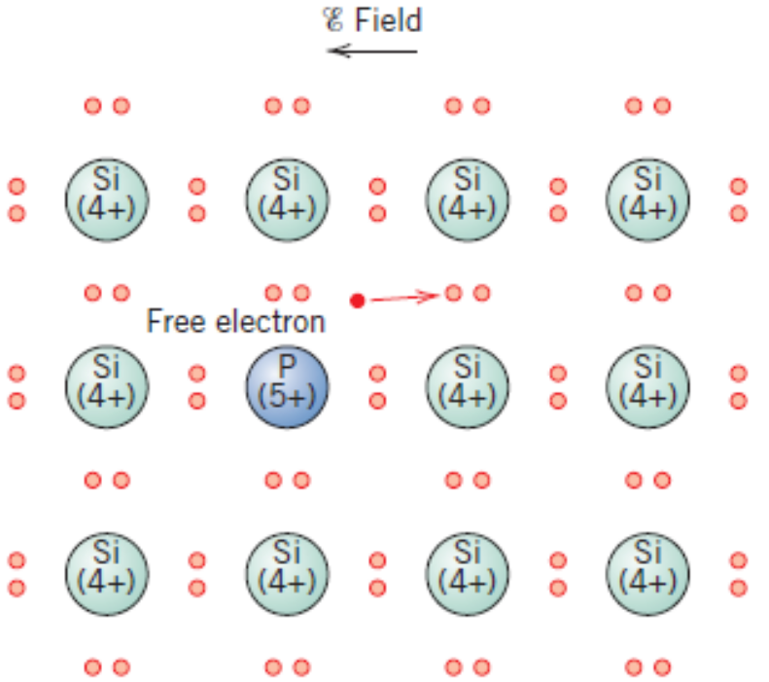
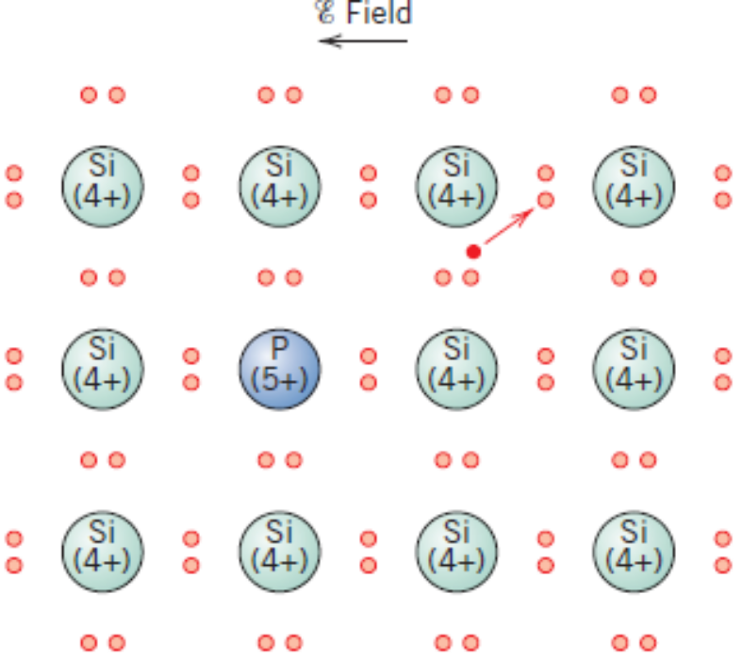
Extrinsic Semiconductors
n – type extrinsic semiconductor

Slide 15
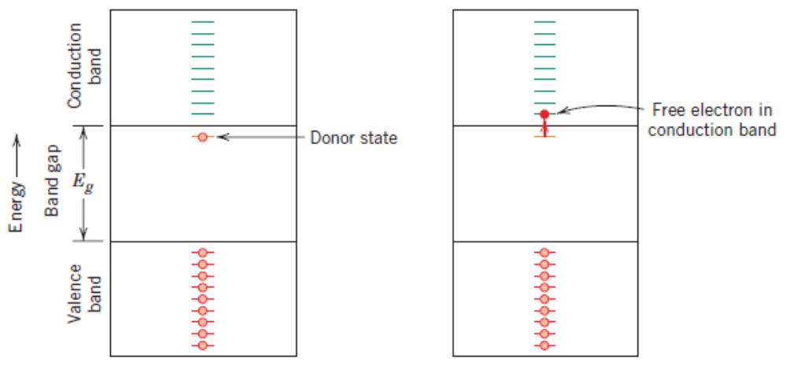
Extrinsic Semiconductors
n – type extrinsic semiconductor

Slide 16
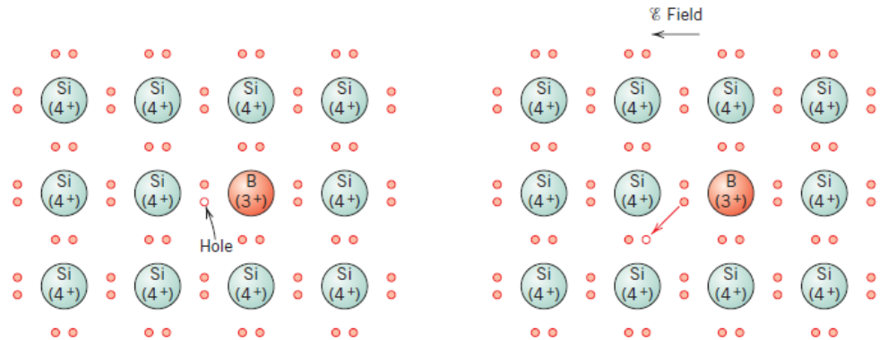
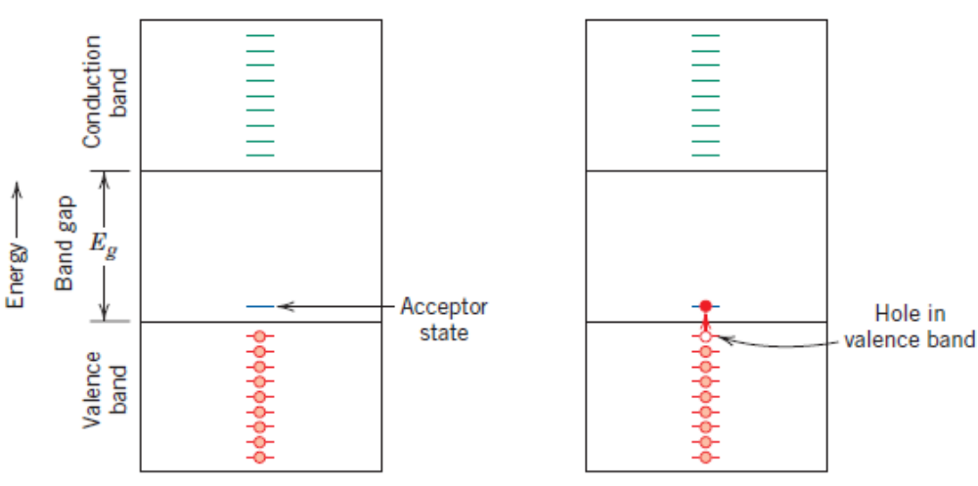
Extrinsic Semiconductors
p–type extrinsic semiconductor

Slide 17
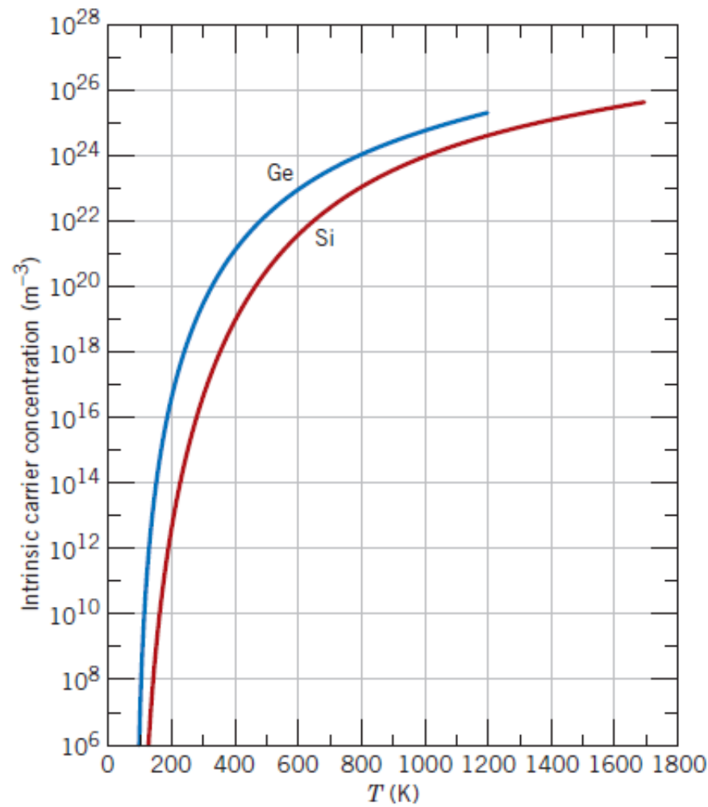
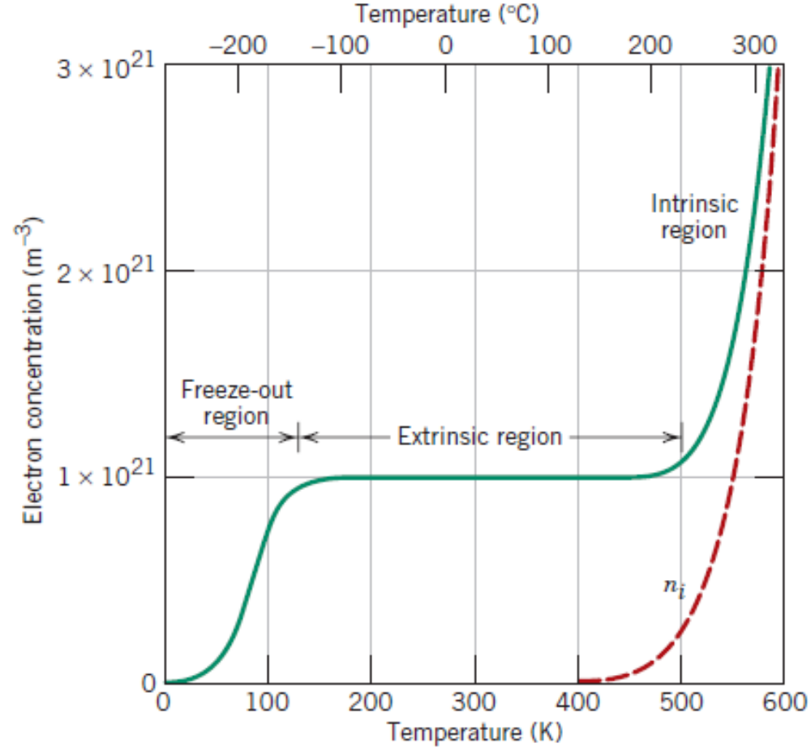
Temperature dependent Semiconductivity
Intrinsic semiconductor
n–type Extrinsic semiconductor
Intrinsic semiconductor
Intrinsic semiconductor

Slide 18
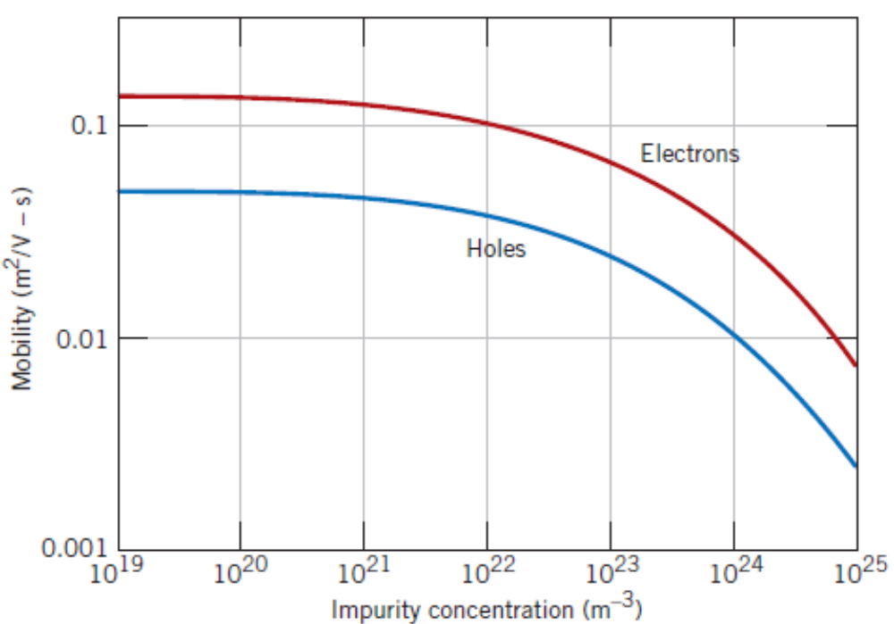
Factors affecting the Carrier mobility
Influence of dopant concentration

Slide 19
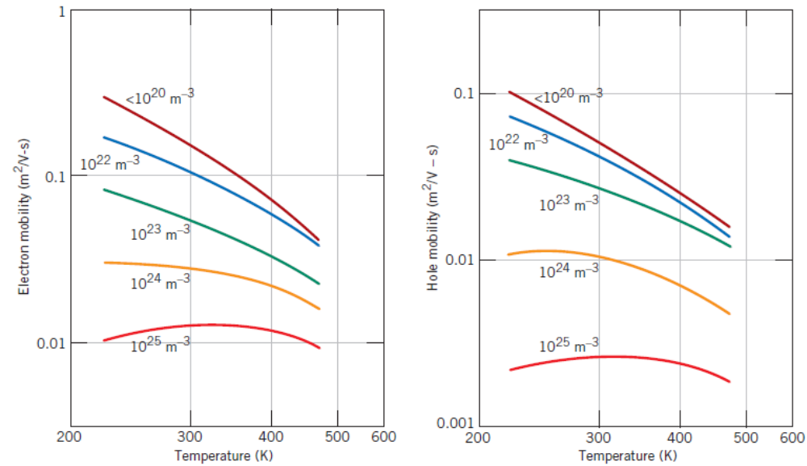
Factors affecting the Carrier mobility
Influence of Temperature

Slide 20
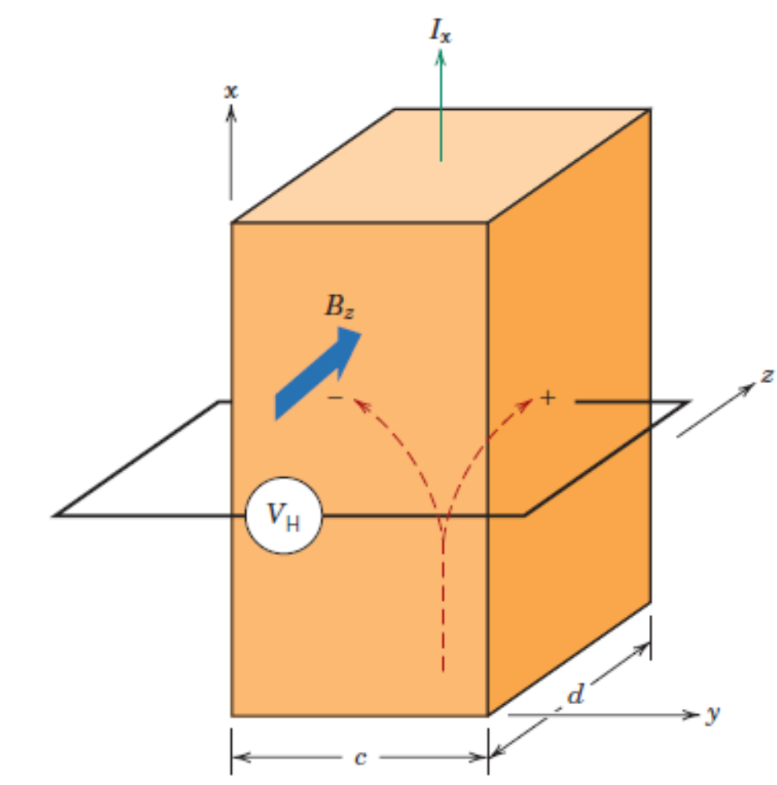
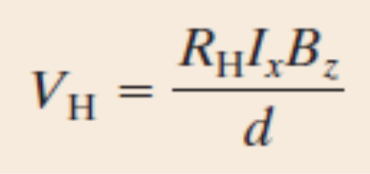
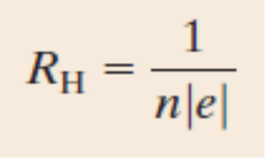
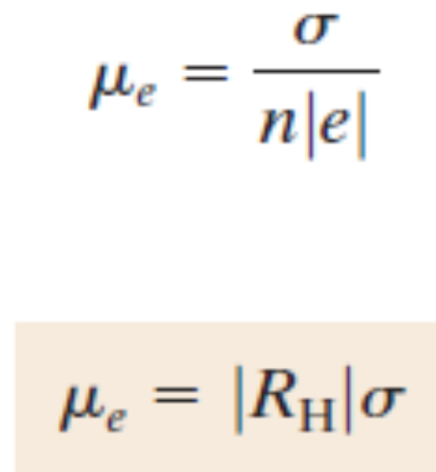
Hall Effect
A magnetic field applied in the direction perpendicular to the direction of motion of a charged particle exerts force in the direction perpendicular to both the magnetic field and the direction of motion.

Slide 21
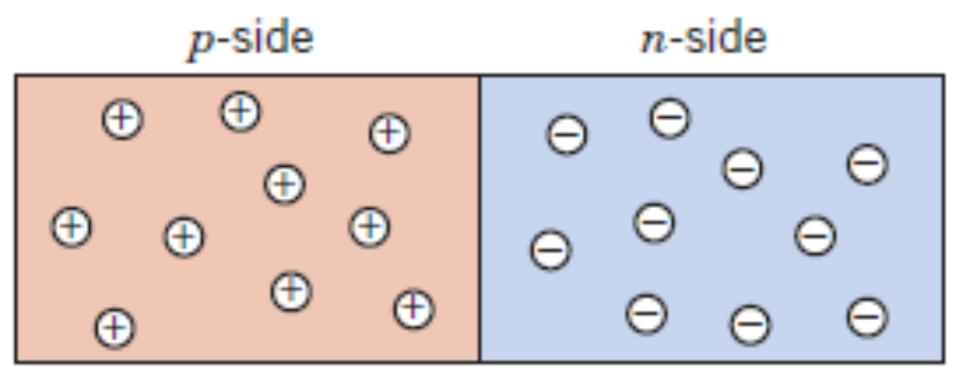
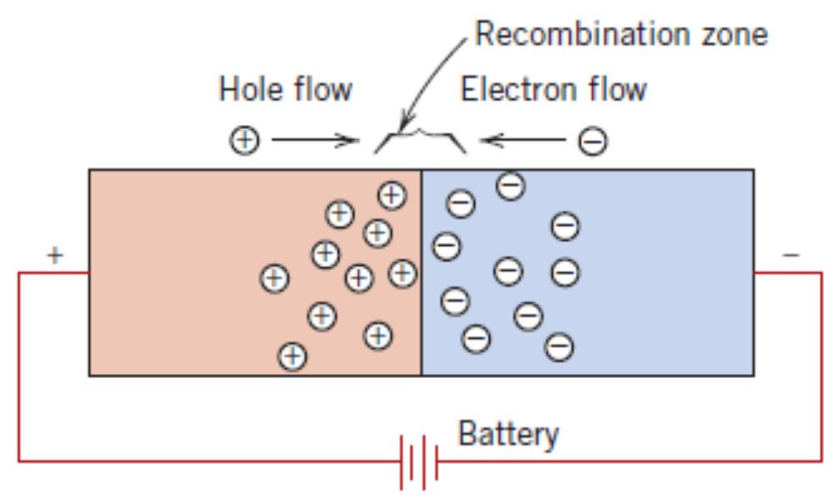
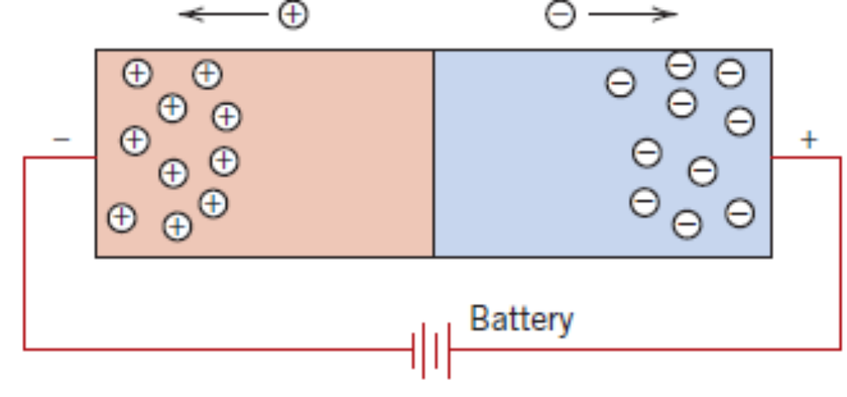
Semiconductor Devices
Forward Bias
Reverse Bias

Slide 22
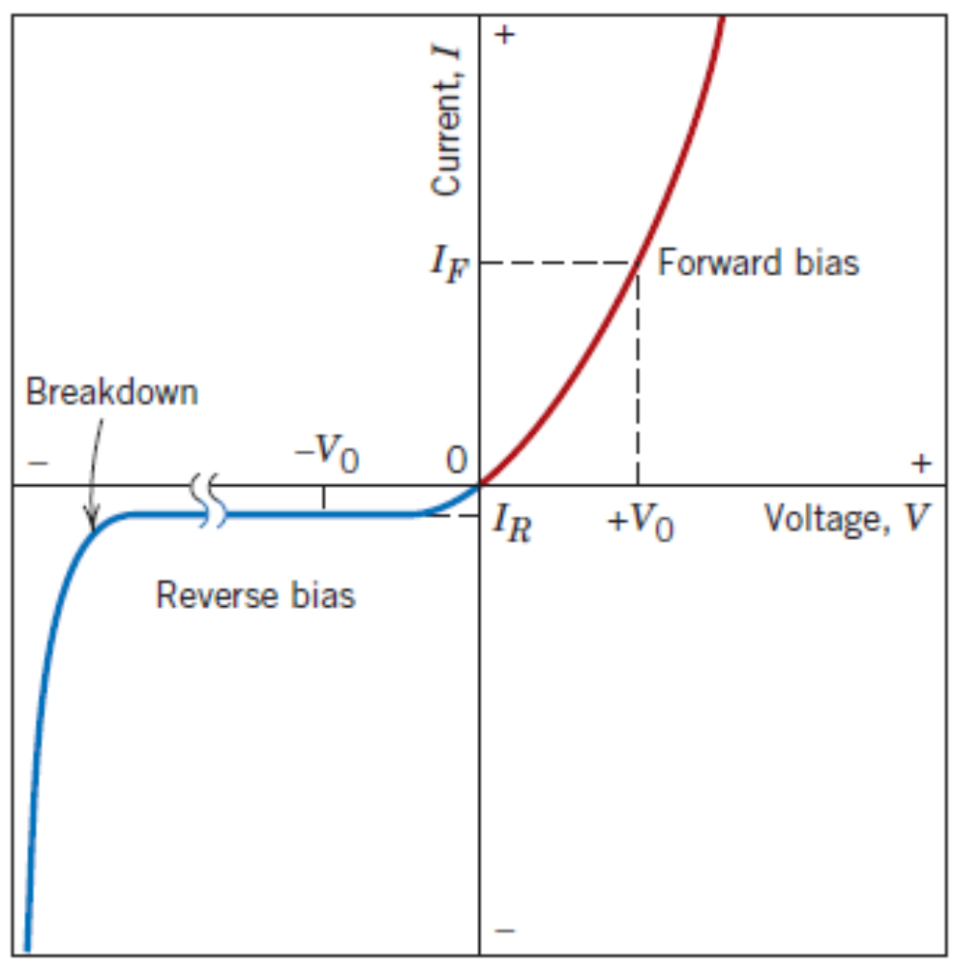
Semiconductor Devices
Forward Bias

Slide 23
Semiconductor Devices
Reverse Bias

Slide 24
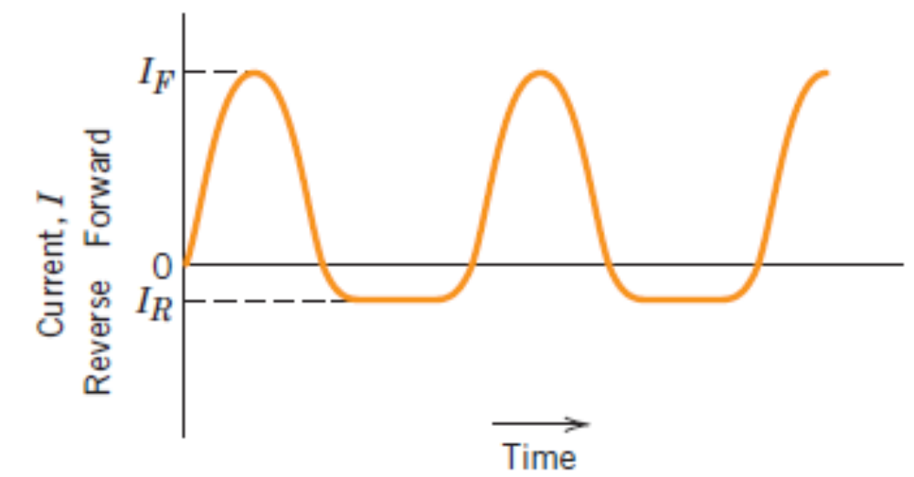
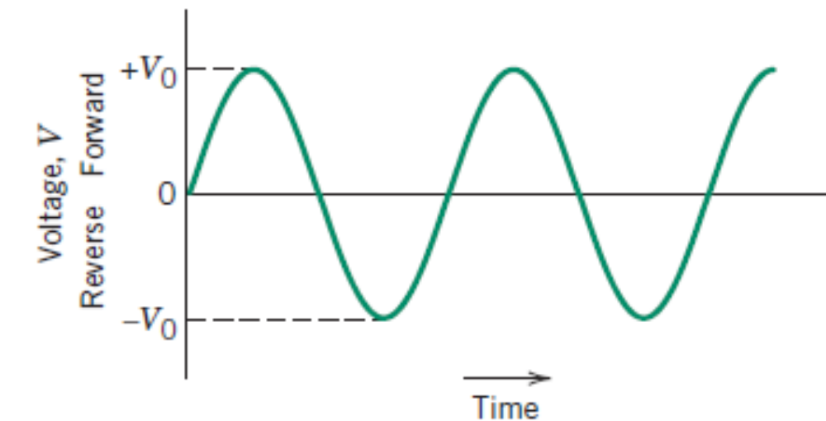
Semiconductor Devices
Input Voltage
Output Current

Slide 25
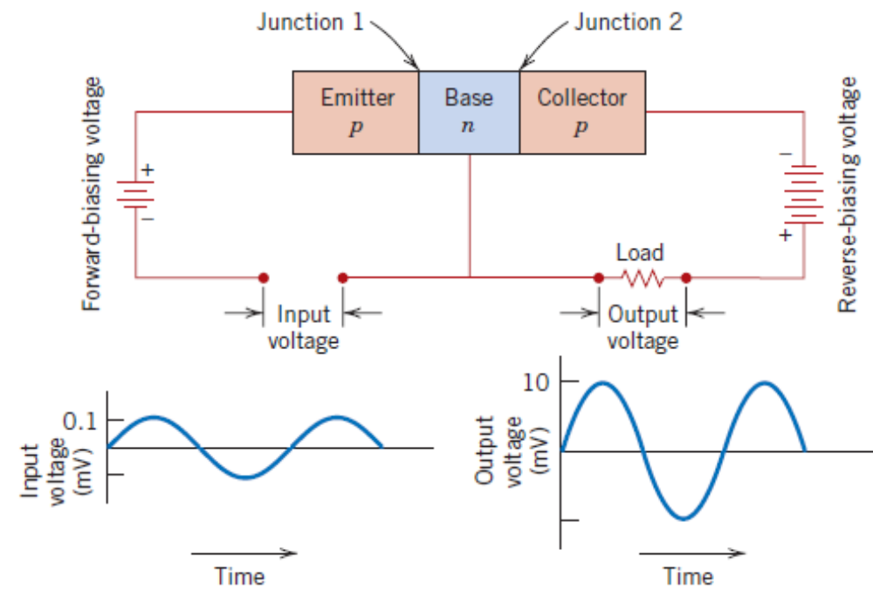
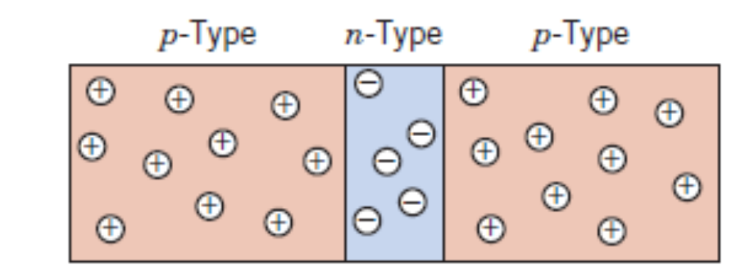
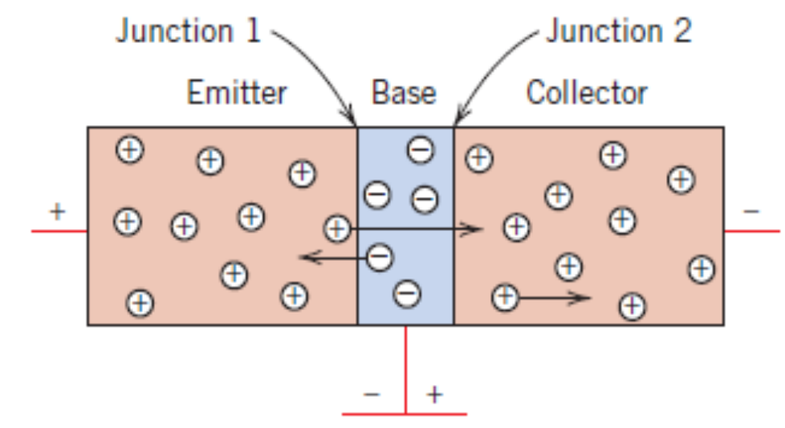
The Transistor
Junction or Bimodal Transistors
Metal Oxide Semiconductors Field–Effect Transistor (MOSFET)

Slide 26
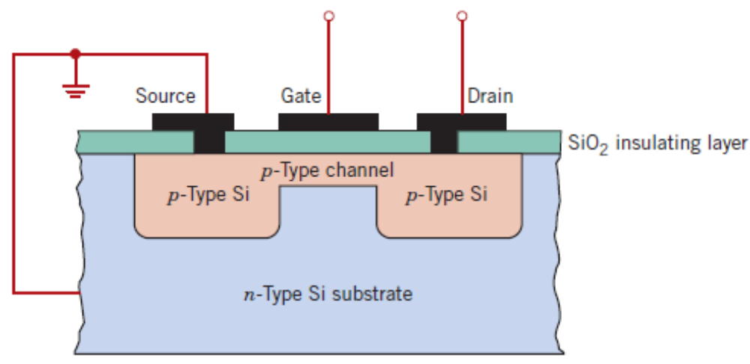
The Transistor
Junction or Bimodal Transistors
Metal Oxide Semiconductors Field–Effect Transistor (MOSFET)
Schematic cross – section of MOSFET

Slide 27
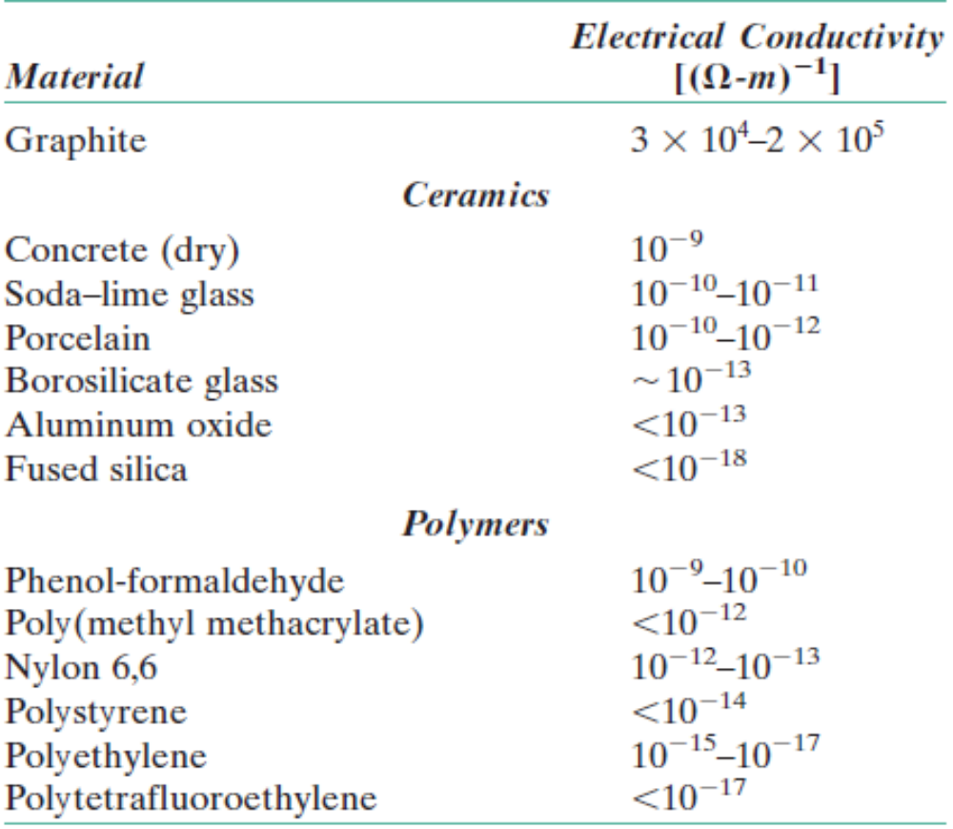
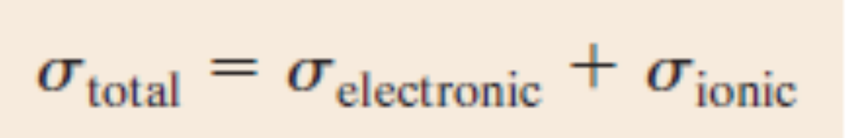


Electrical Conduction in Ionic Ceramics and Polymers
In ionic Ceramics, conduction of current takes place through electron and ionic motion.
Polyacetylene

Slide 28



Dielectric Behaviour
Dielectric materials are insulators (non–metallic). Used in capacitors.
Capacitance, C = Q/V. Units are Farad.
In a parallel–plate capacitor with vacuum in between, $C=ε_{0}\frac{A}{l}$, $ε_{0}=8.85×{10}^{−12}$ F/m.
In any other medium $C=ε\frac{A}{l}$.
$ε_{r}$is the relative permittivity or dielectric constant.

Slide 29



Field Vectors and Polarization
Dipole getting aligned along the direction of electric field – Polarization

Slide 30


Field Vectors and Polarization
Surface charge per unit area or charge density D is given by,
D₀ = ϵ₀E in vacuum
D = ϵE for any dielectric material.
D is sometimes called dielectric displacement.
D = ϵ₀E + P; P = ϵ₀ (ϵ_{r} – 1)E

Slide 31
Field Vectors and Polarization
Consider a parallel-plate capacitor having an area of 0.0006 m² and a plate separation of 0.002 m across which a potential of 10 V is applied. If a material having a dielectric constant of 6.0 is positioned within the region between the plates, compute
The capacitance.
The magnitude of the charge stored on each plate.
The dielectric displacement D.
The polarization.

Slide 32



Types of Polarization
Electronic Polarization
Ionic Polarization
Orientation Polarization
Electronic polarization that results from the distortion of an atomic electron cloud by an electric field.
Response of permanent electric dipoles (arrows) to an applied electric field, producing orientation polarization.
Ionic polarization that results from the relative displacements of electrically charged ions in response to an electric field.

Slide 33


Frequency dependence of dielectric constant
An applied voltage of alternating direction

Slide 34

Frequency dependence of dielectric constant

Slide 35


Ferroelectricity
Spontaneous polarization – a dielectric analogue to ferromagnetism

Slide 36

Piezoelectricity
Application of stress induces voltage. Applications–transducers, phonograph cartridges, speakers, audible alarms.

